Slide 1
Automatic Speech Recognition
Research opportunities and possibilities

Slide 2
Why it is important
More demands on hands-free applications.
Autopilot
Self-driving cars
Mobile applications
Future robots are going to listen and talk.
Smart Cities are coming.
Notes:
There are plenty of applications that use ASR technology nowadays. The natural language translation, such as the recent Skype service. It is also used to convert voice messages to text, so that it can be emailed to the recipient later. Other examples are short text dictation, voice search, personal digital assistant, gaming, living room interaction systems, and in-vehicle infotainment systems

Slide 3
Current Research
Sentinel Word Recognition (aka WUW Recognition)
Wake-Up-Word (WUW) is a new paradigm in speech recognition (SR) that is not yet widely recognized.
Dr. Veton Këpuska is one of the pioneers in this field.
It is detection of a single word or phrase when spoken in the alerting context of requesting attention, while rejecting all other acoustic events.

Slide 4
http://lovemyecho.com/2015/11/11/echo-custom-wake-words-why-isnt-this-a-thing-yet/
The study and analysis of wake words is an entire category of voice synthesis engineering unto itself. Consider this excerpt, “Wake Up Word Recognition” from the book Speech Technologies, ISBN 978-953-307-996-7. This excerpt is from a chapter written by Veton Kepuska:
[A Wake Up Word] has the following unique requirement: Detect a single word or phrase when spoken in an alerting context, while rejecting all other words, phrases, sounds, noises and other acoustic events with virtually 100% accuracy including the same word or phrase of interest spoken in a non-alerting (i.e. referential) context.

Slide 5
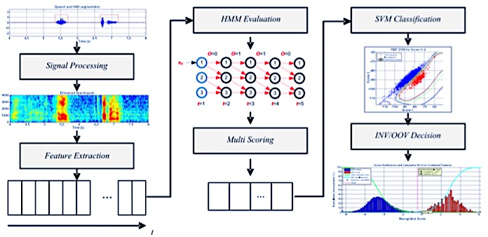
Current Research
Sentinel Word Recognition (aka WUW Recognition)

Slide 6
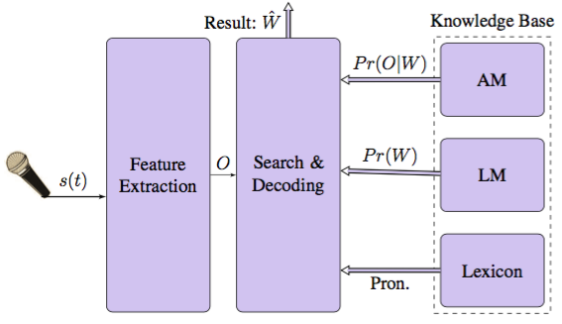
Current Research
Automatic Speech Recognition Adaptation for Various Noise Levels
Notes:
Every module is topic in itself

Slide 7
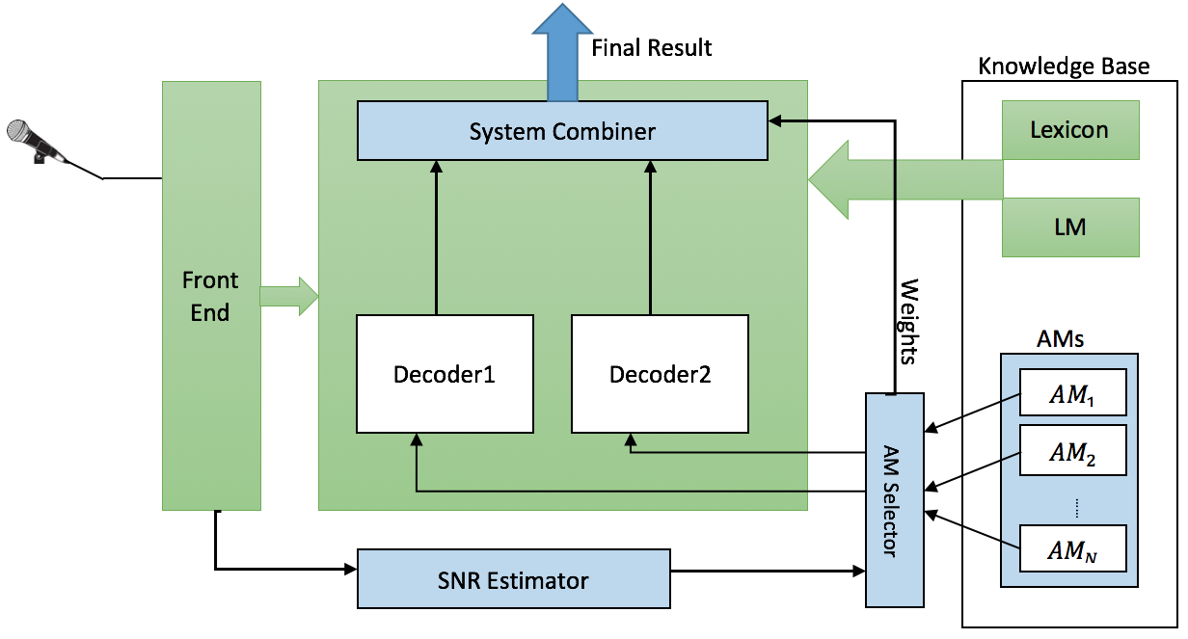
Current Research
Automatic Speech Recognition Adaptation for Various Noise Levels

Slide 8
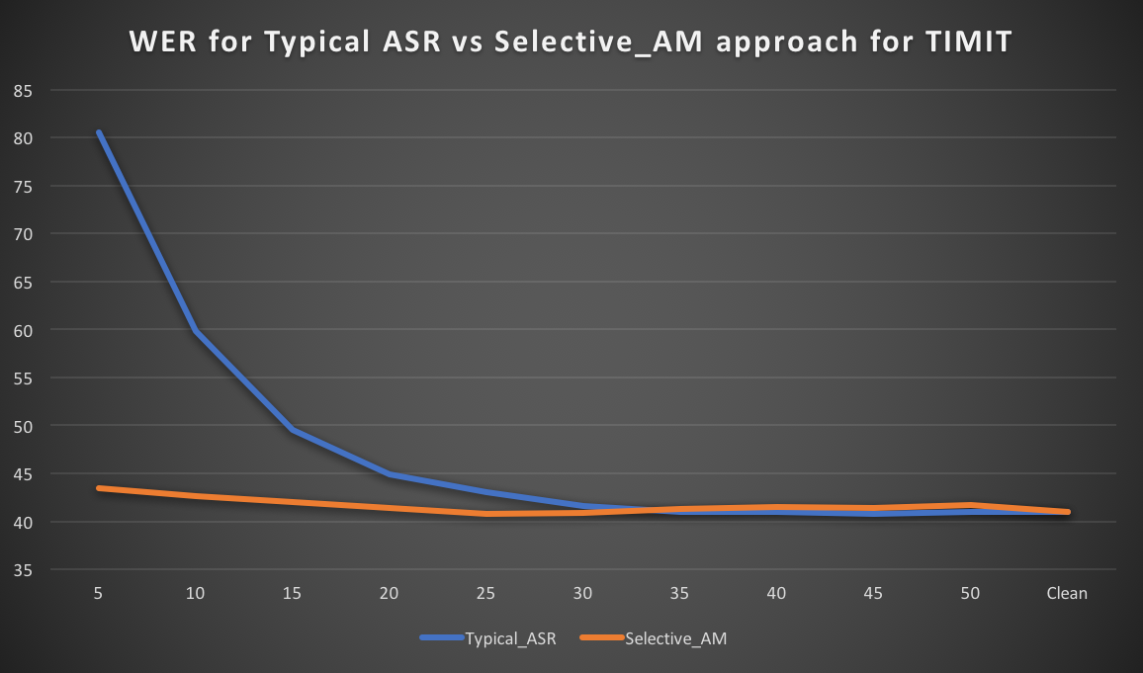
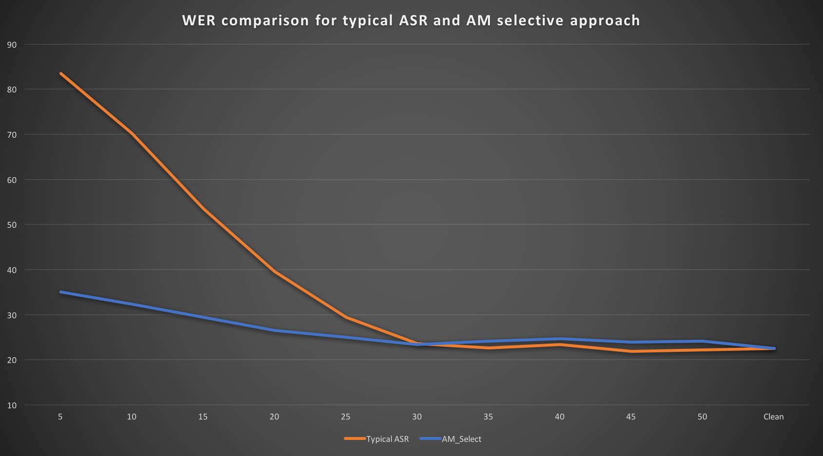
Current Research
Automatic Speech Recognition Adaptation for Various Noise Levels

Slide 9
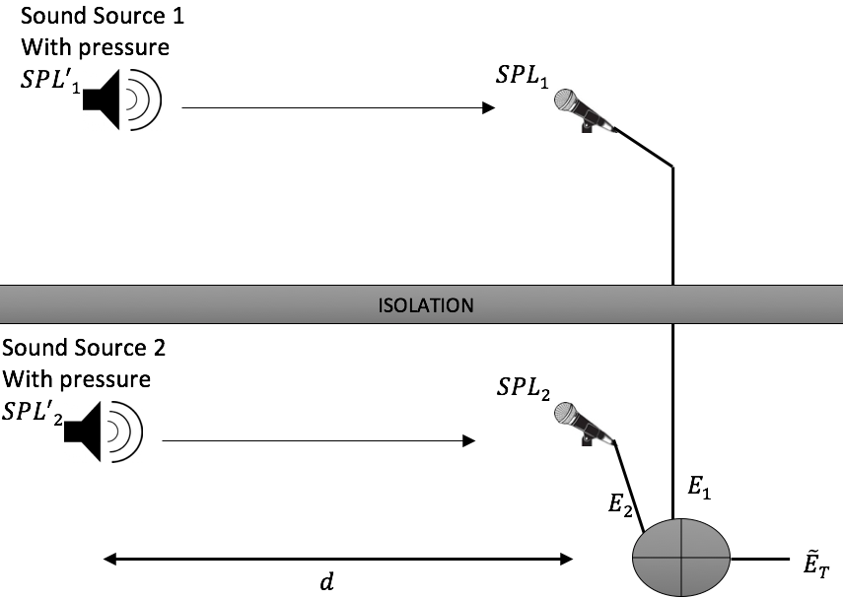
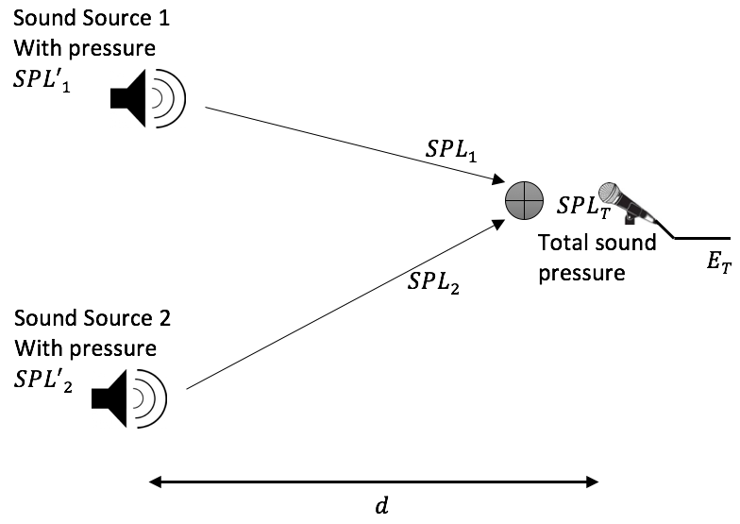
Current Research
Acoustic Noise Simulation

Slide 10
More Research Ideas
Acoustic features
Improve ASR recognition rate.
Measure similarities between two audio files, can be used for audio search engine.
Machine learning
HMM and related technologies
NN and DNN
HMM-DNN hybrid systems
Natural language parsing
Post-recognition speech understanding.

Slide 11
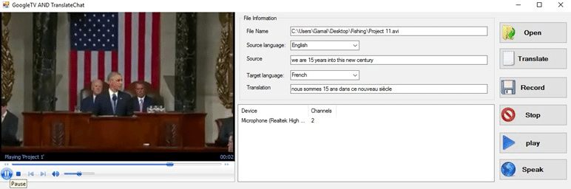
Live Speech Translation

Slide 12

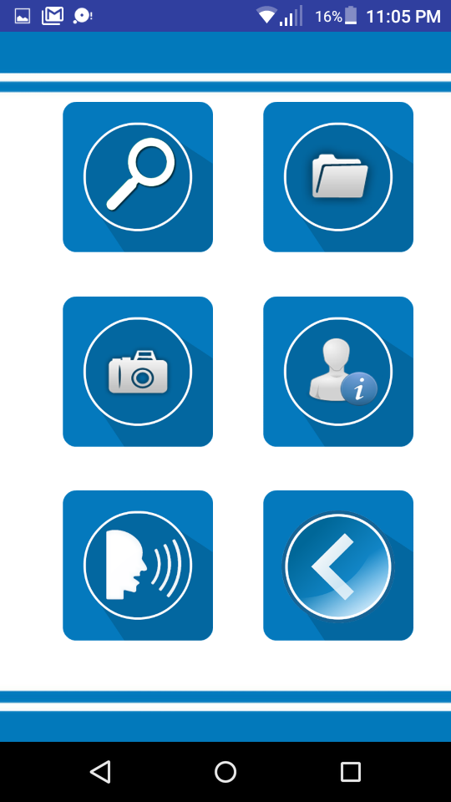
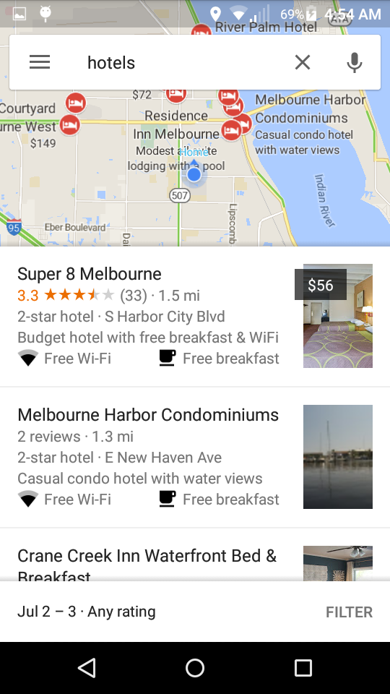

https://www.youtube.com/watch?v=OYrTImQrjqY&t=48s
Speech Command Software - Android App

Slide 13
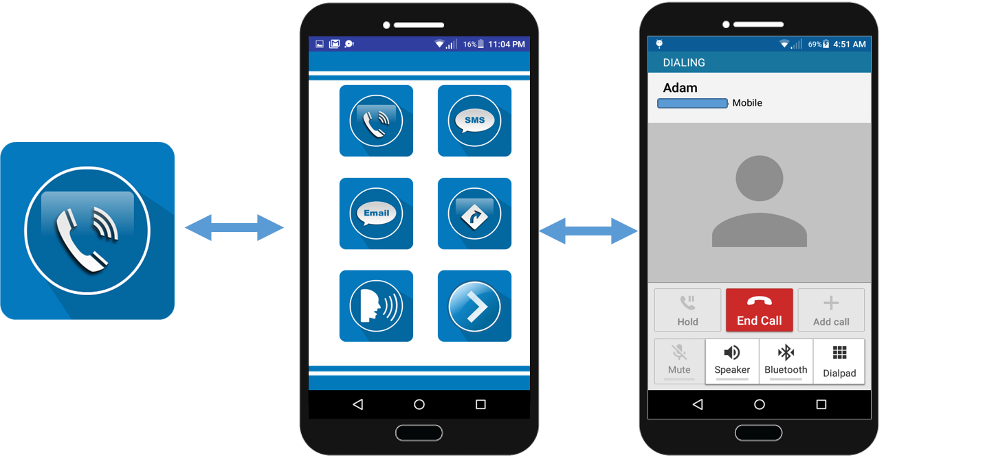
https://www.youtube.com/watch?v=OYrTImQrjqY&t=48s
Speech Command Software - Android App

Slide 14
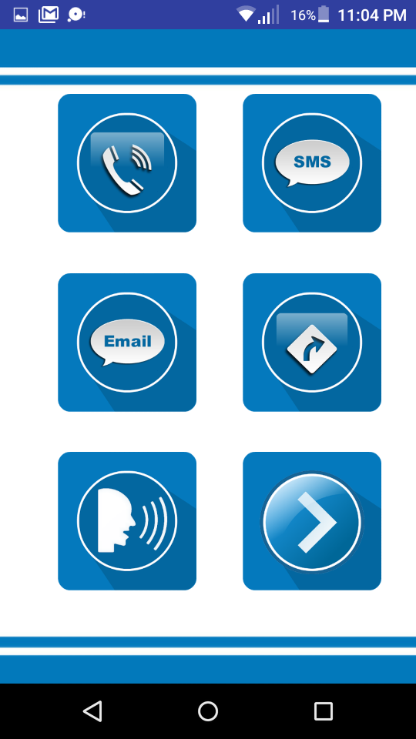
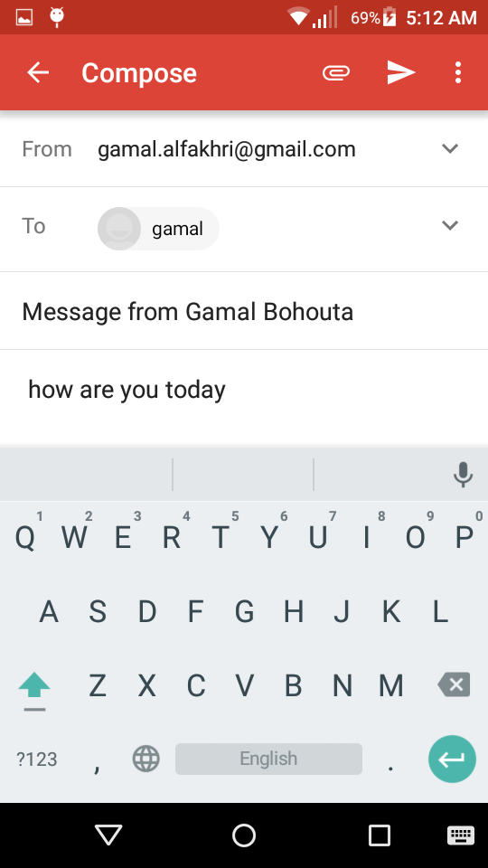

https://www.youtube.com/watch?v=OYrTImQrjqY&t=48s
Speech Command Software - Android App

Slide 15
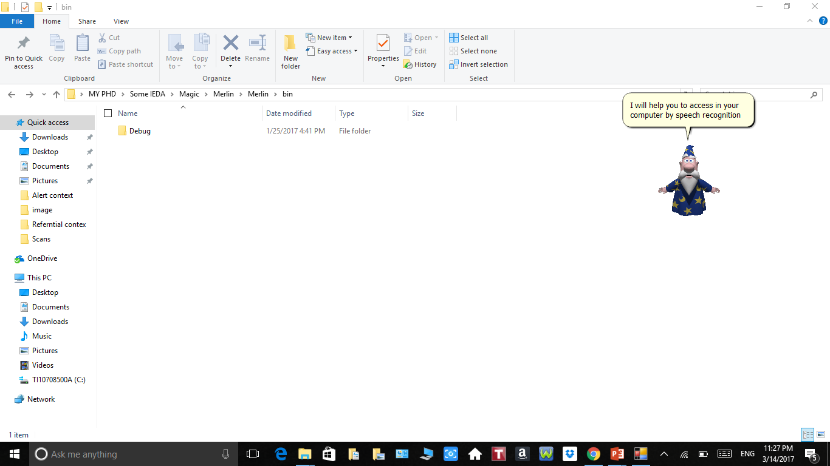
https://www.youtube.com/watch?v=At1LsJAcaeQ&t=171s
Speech Command Software - Windows App

Slide 16
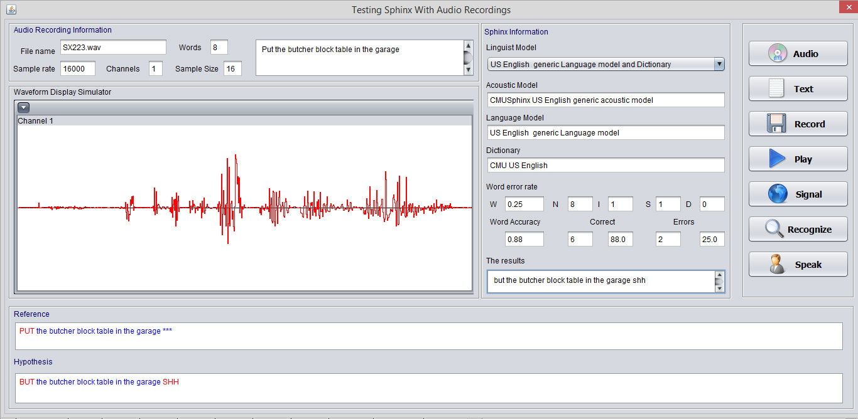
Testing the components of Sphinx-4

Slide 17
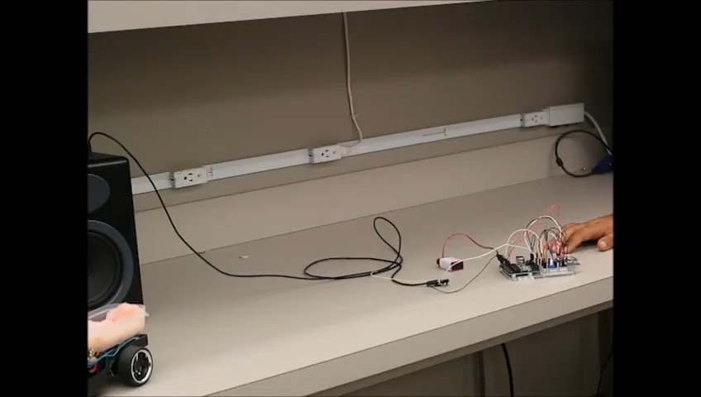
Hands-free platform control

Slide 18
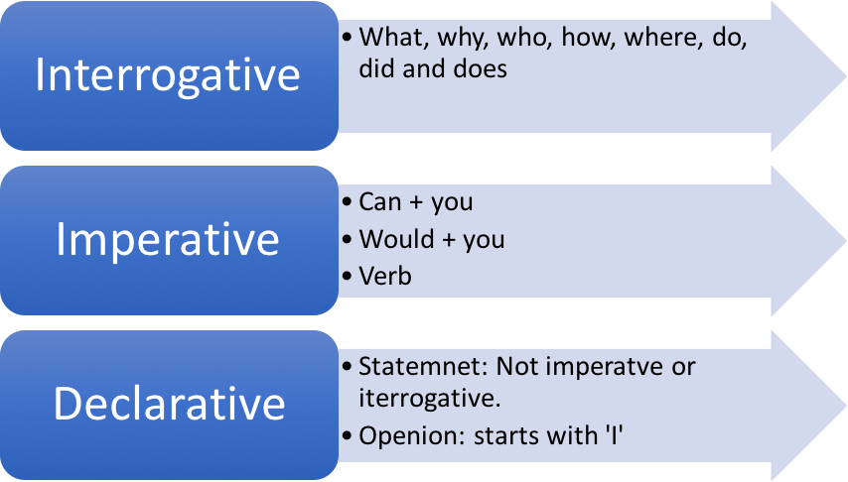
Machine-Human Discourse

Slide 19
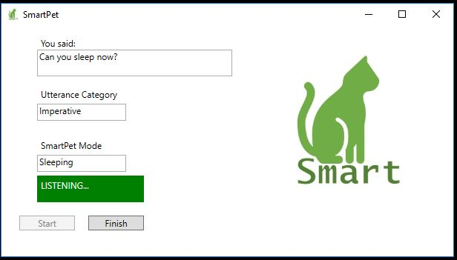
Machine-Human Discourse

Slide 20
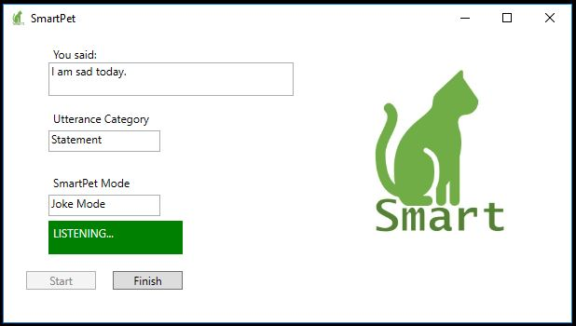
Machine-Human Discourse

Slide 21
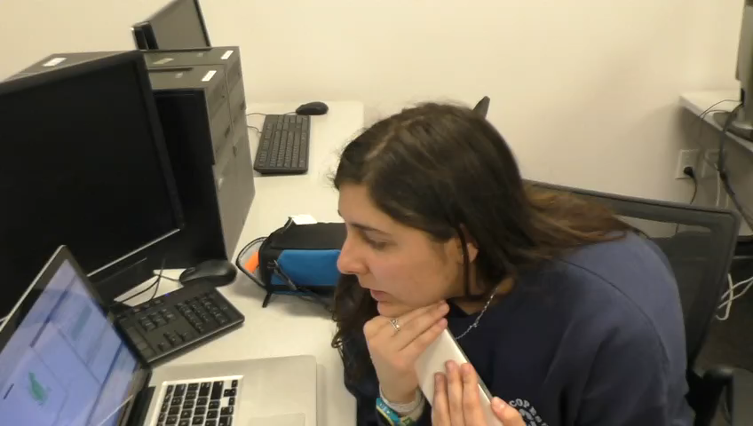
Machine-Human Discourse

Slide 22
More Apps Ideas
It is the era of APIs.
Microsoft, google, bing and many other companies offer speech-to-text API.
APIs could be used for computer and mobile applications
CMU Sphinx, Kaldi are the top open source ASR tools.
CMU Sphinx is easy to use JAVA platform which could be plugged to your application easily.

Slide 23


